Slide 1
Getting Started with Cross-Platform Open-Source C++
@dorodnic
20/11/2018

Slide 2
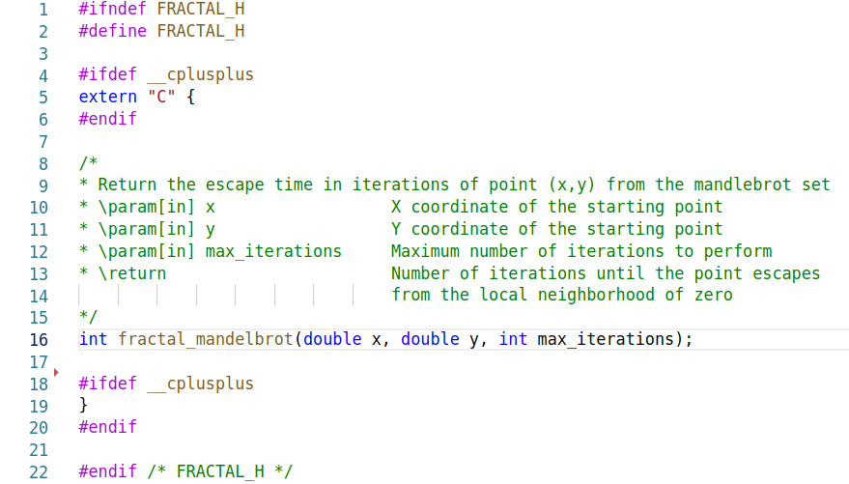
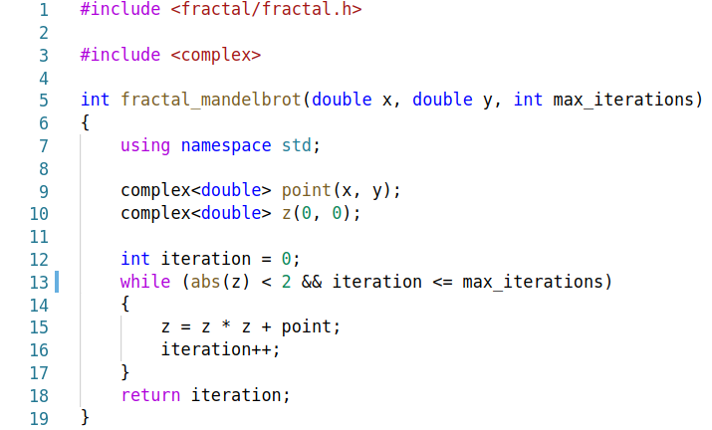
The Easy Part :)
fractal.h: fractal.cpp:

Slide 3
Asking the Real Questions
Where to manage the code?
How to make sure it compiles on different platforms and tool-chains?
How to test that it works?
How people are supposed to use the library?
Where to host the documentation and how to keep it up-to-date?
How to package the library for different platforms and usages?
How to make the library accessible from other languages?

Slide 4




Modern C++ Utility Belt
GitHub Catch CMake Travis CI

Slide 5
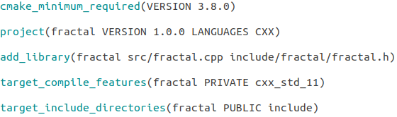
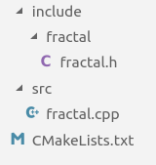
CMake
Instead of maintaining an sln file, and a makefile, and an XCode project CMake will generate these for you, and then some! CMakeLists.txt:

Slide 6
CMake
mkdir build && cd build
cmake ..
cmake --build .

Slide 7
CMake
mkdir build && cd build
cmake .. -DCMAKE_BUILD_TYPE=Release
cmake --build . --config Release

Slide 8
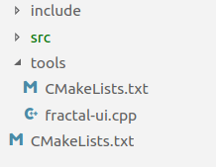
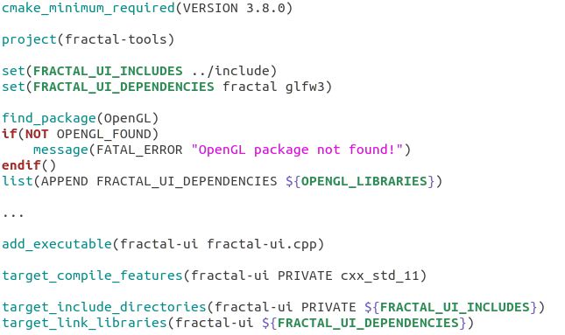

CMake
CMake is meant to be modular tools/CMakeLists.txt:
CMakeLists.txt:

Slide 9
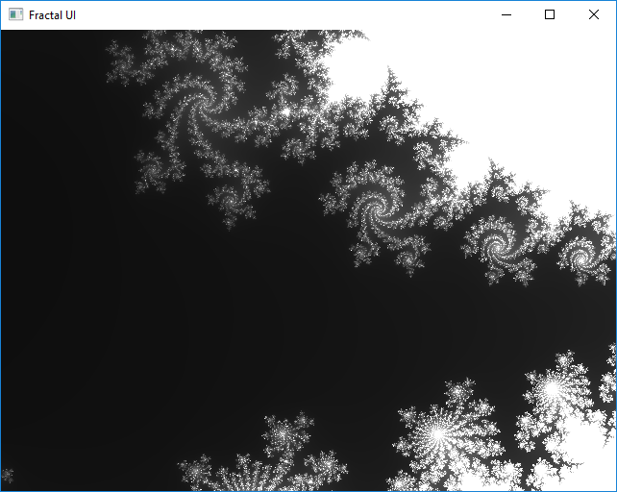
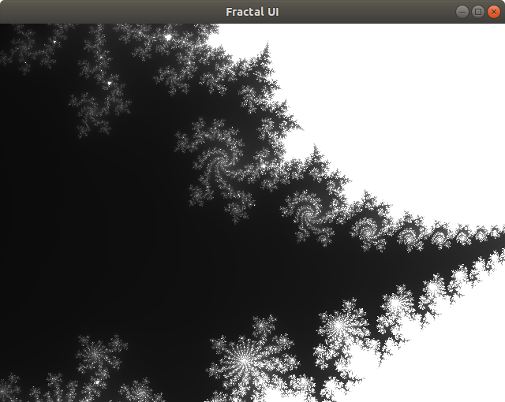
CMake
cmake .. -DBUILD_TOOLS=true && cmake --build .
Windows 10: Ubuntu 16.04:

Slide 10
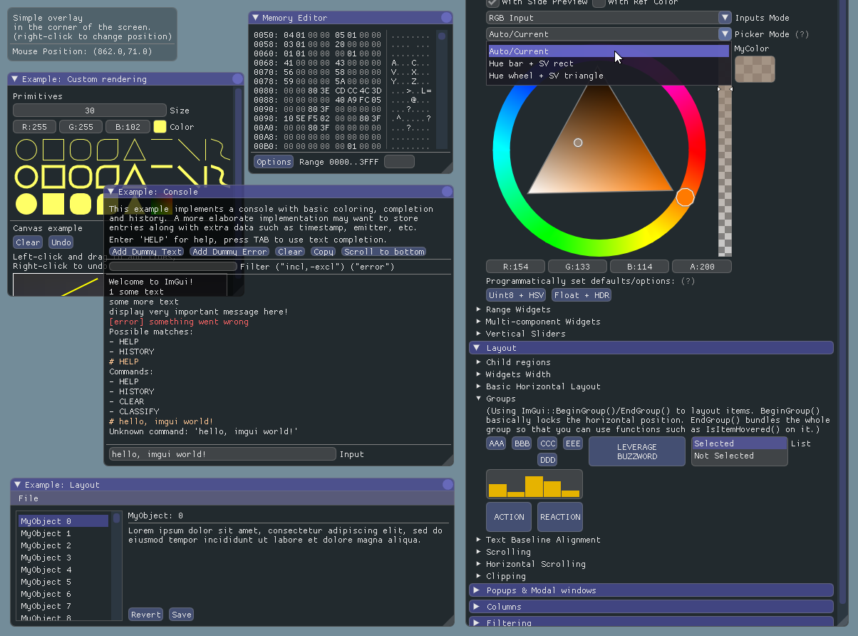
Quick tip: Most bare-bone cross-platform C++ UI recipe:
OpenGL +
GLFW +
ImGui

Slide 11
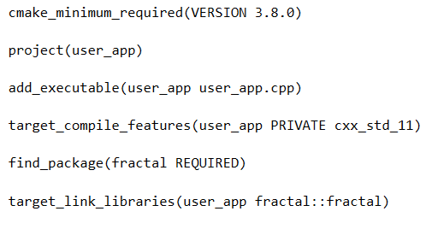
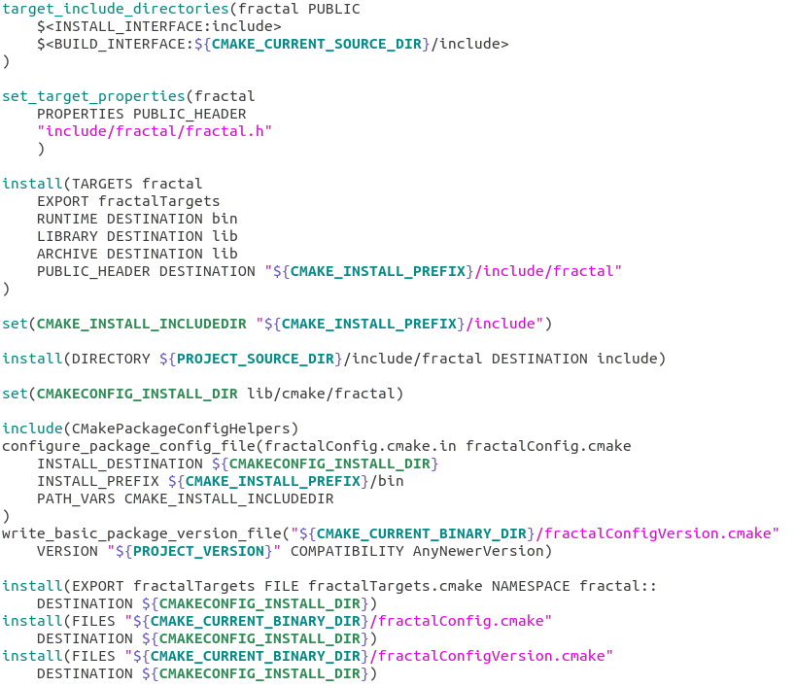
CMake - User Side
User’s CMakeList.txt: Our CMakeList.txt:

Slide 12

CMake - User Side
Users App: Our Library (when building from source):
find_package looks for fractalConfig.cmake in known locations
sudo make install (or the install target on Windows) generates fractalConfig.cmake and copies it to a known location
fractalConfig.cmake

Slide 13
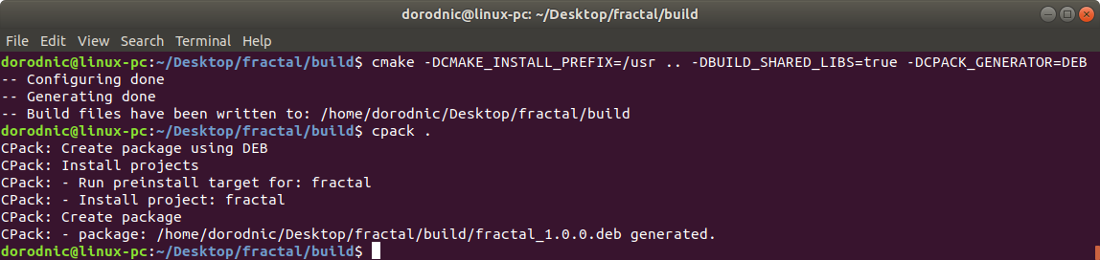
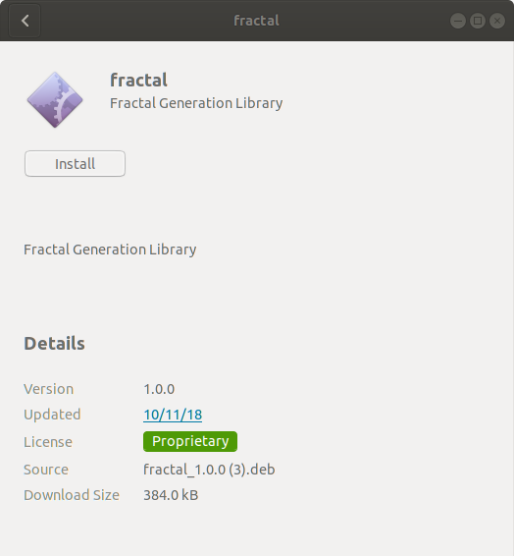
CPack - Packaging
CPack is to Installers is what CMake is to Build-Systems:

Slide 14
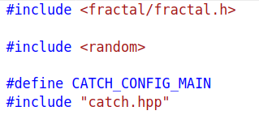
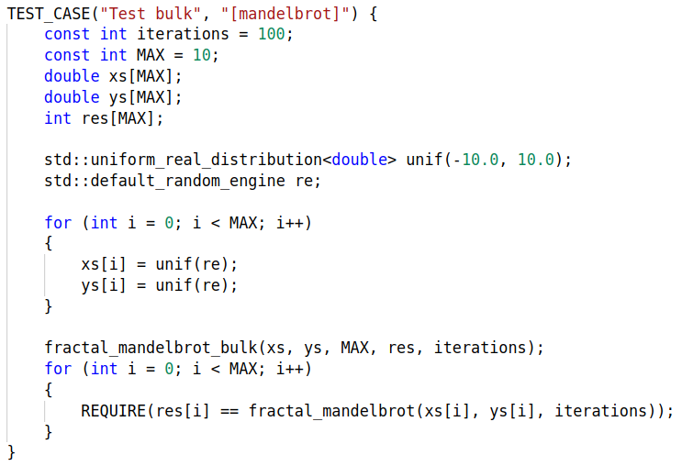
Catch2 - Unit-test Library
Single header library, just fetch catch.hpp from:
github.com/catchorg/Catch2/releases/download/v2.4.2/catch.hpp

Slide 15
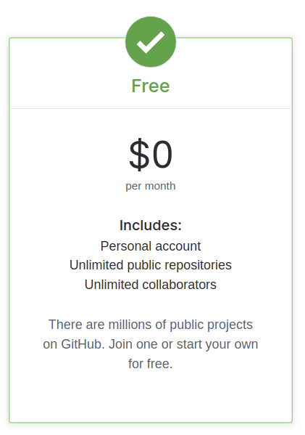
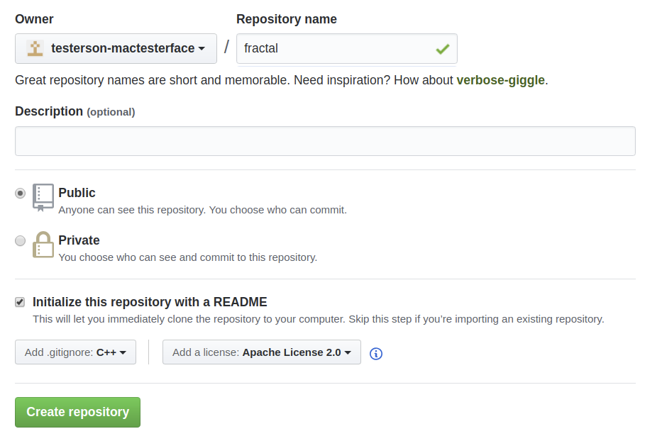
GitHub

Slide 16
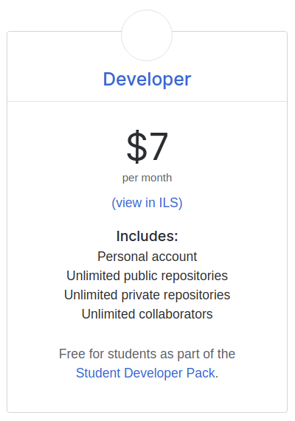

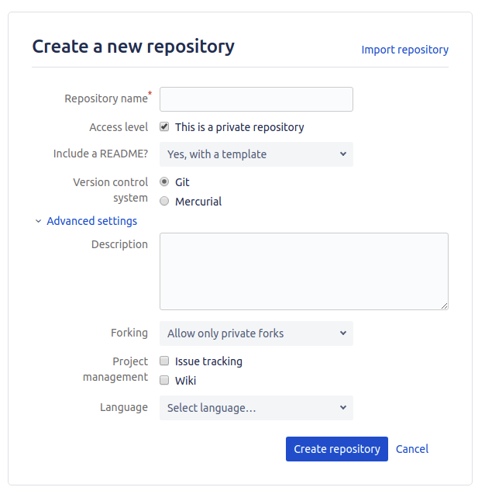
GitHub - Secretive Type?
OR ...

Slide 17
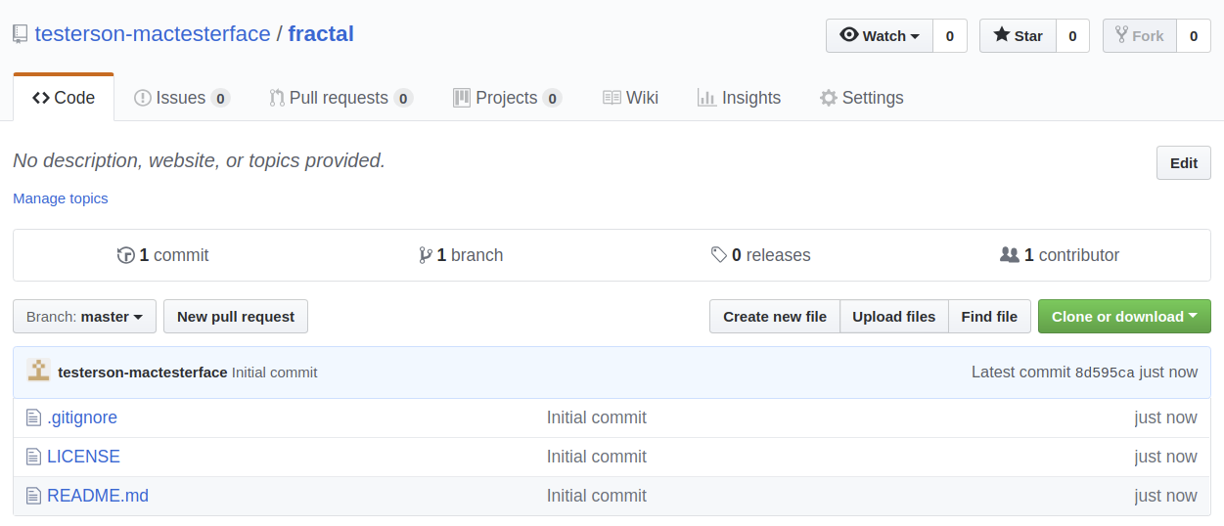
GitHub

Slide 18
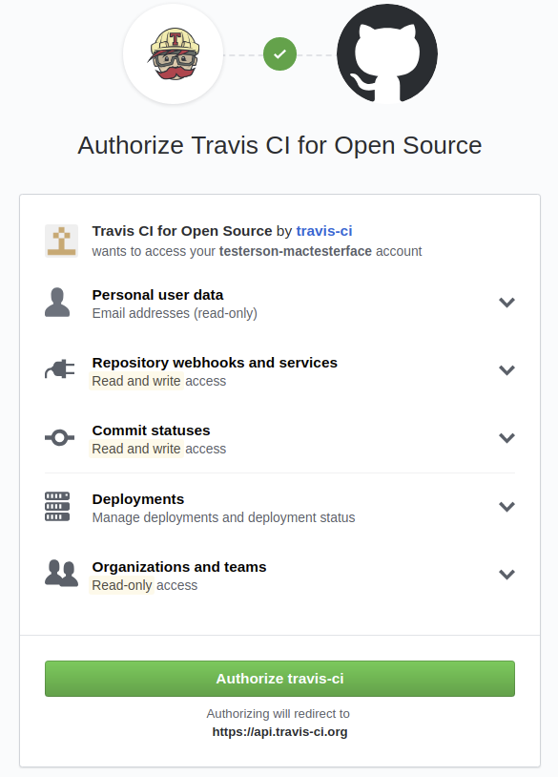
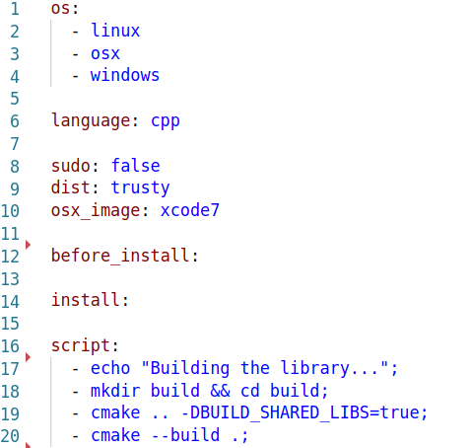
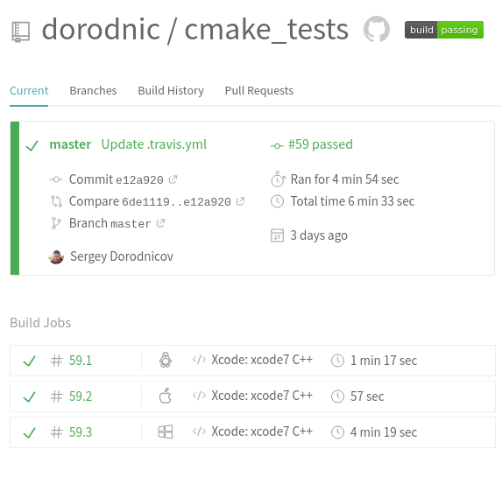

Travis CI - Free Builds in the Cloud
Step 1: Add .travis.yml Step 2: Authorize Travis CI Step 3: Profit!

Slide 19
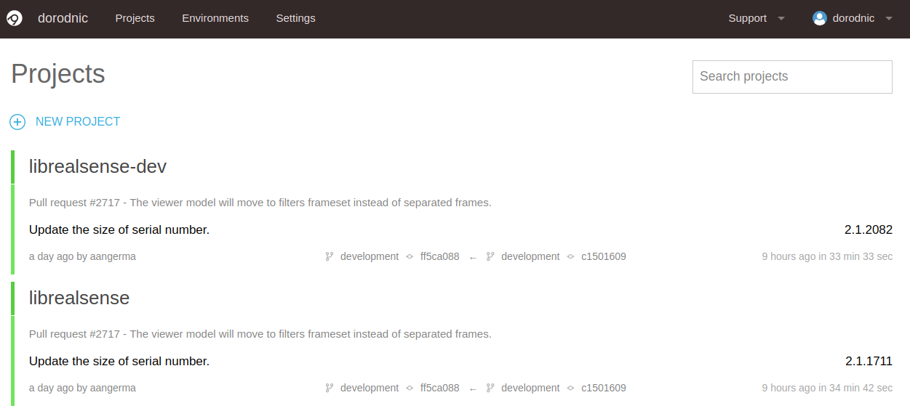
Travis CI - Free Builds in the Cloud
Same idea but with more emphasis on Microsoft ecosystem:

Slide 20
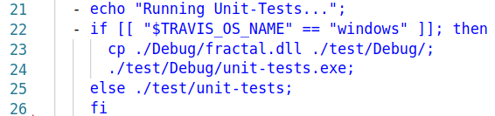
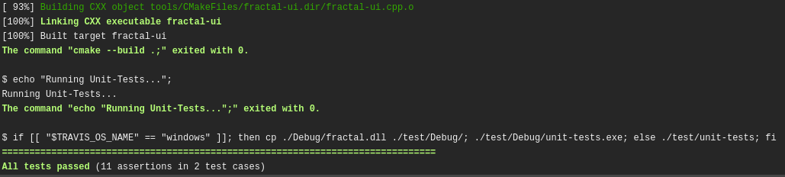
Travis CI - Adding Tests

Slide 21
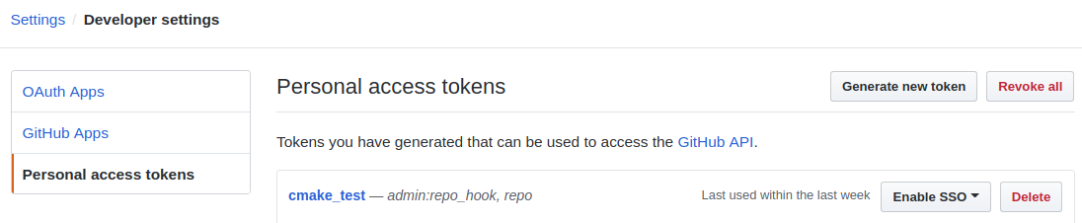
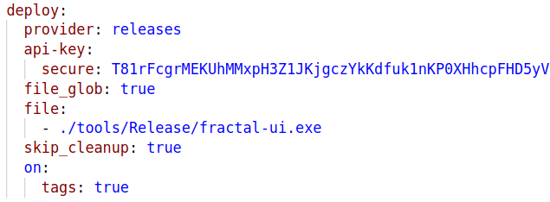
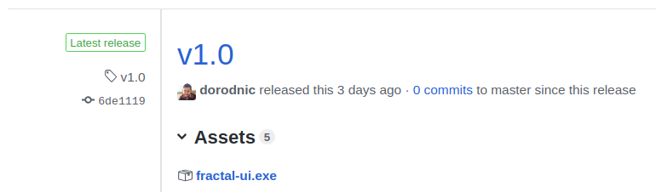
Travis CI - Publishing Artifacts
sudo apt-get install ruby-dev
sudo gem install travis
travis encrypt GITHUB_TOKEN="5d4lalalalalalalalalalalalalalalalalala0f5"

Slide 22

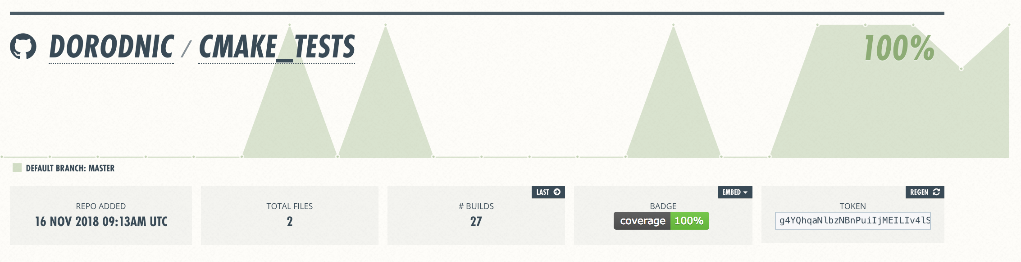
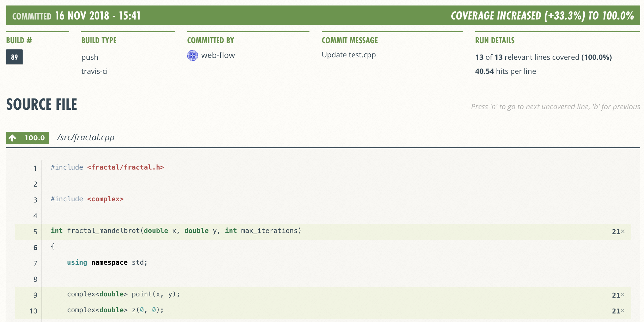
Coveralls - Code-Coverage

Slide 23
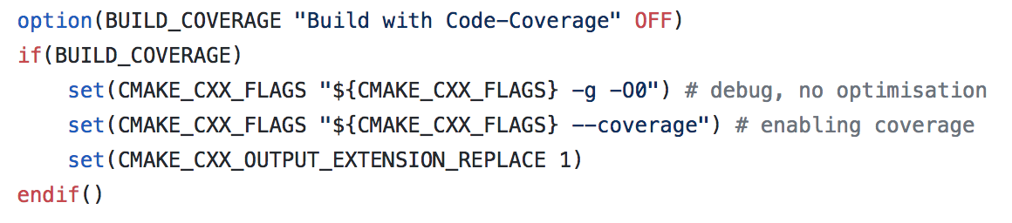
Coveralls - Code-Coverage
# Install CppCoveralls:
pip install --user cpp-coveralls
# Build with coverage support:
cmake .. -DBUILD_COVERAGE=true
# Send data to coveralls:
coveralls --exclude tools --exclude test --exclude build --gcov-options '\-lp';

Slide 24
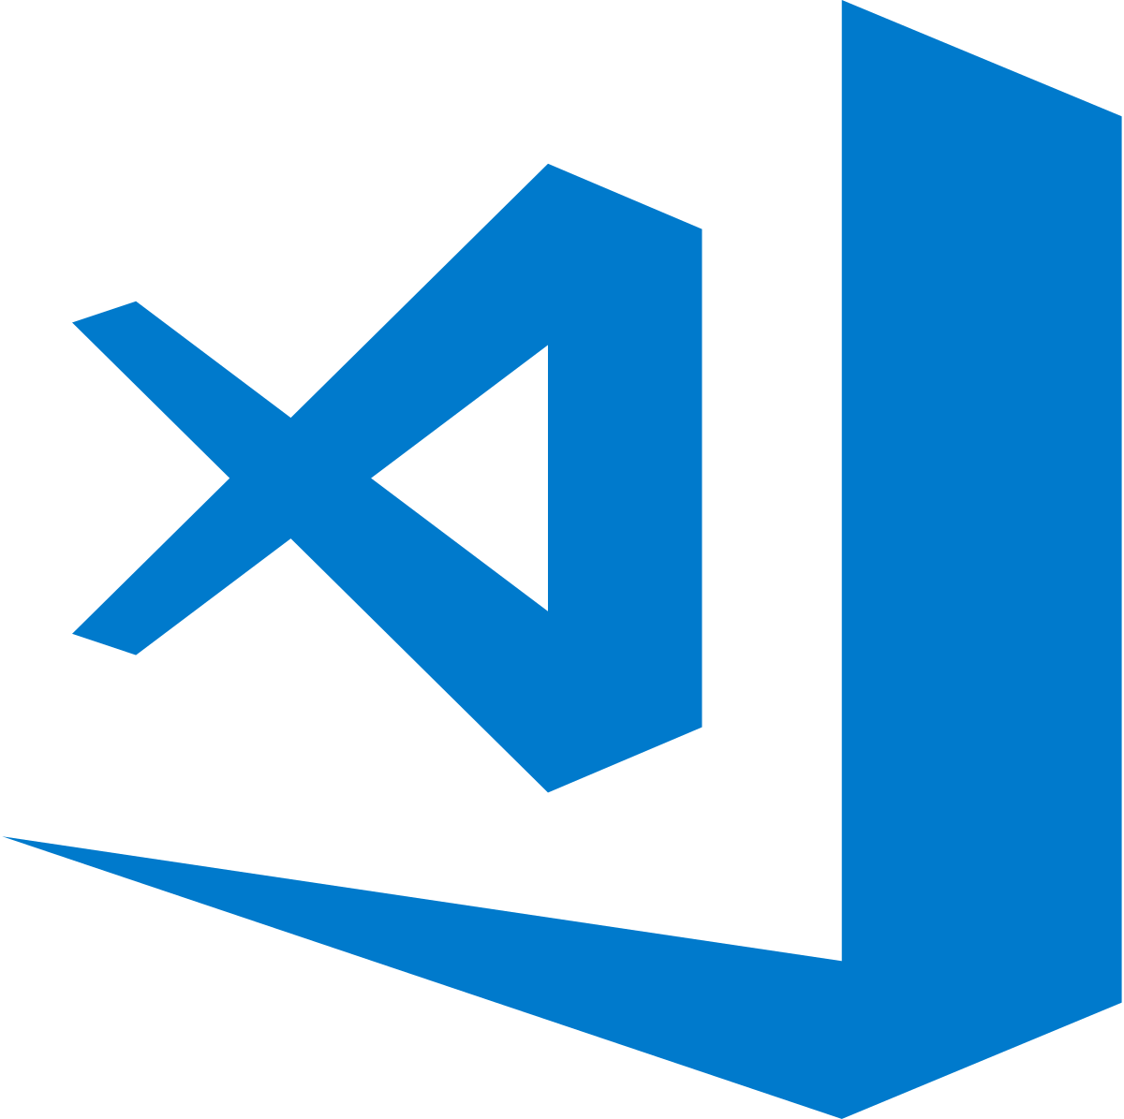
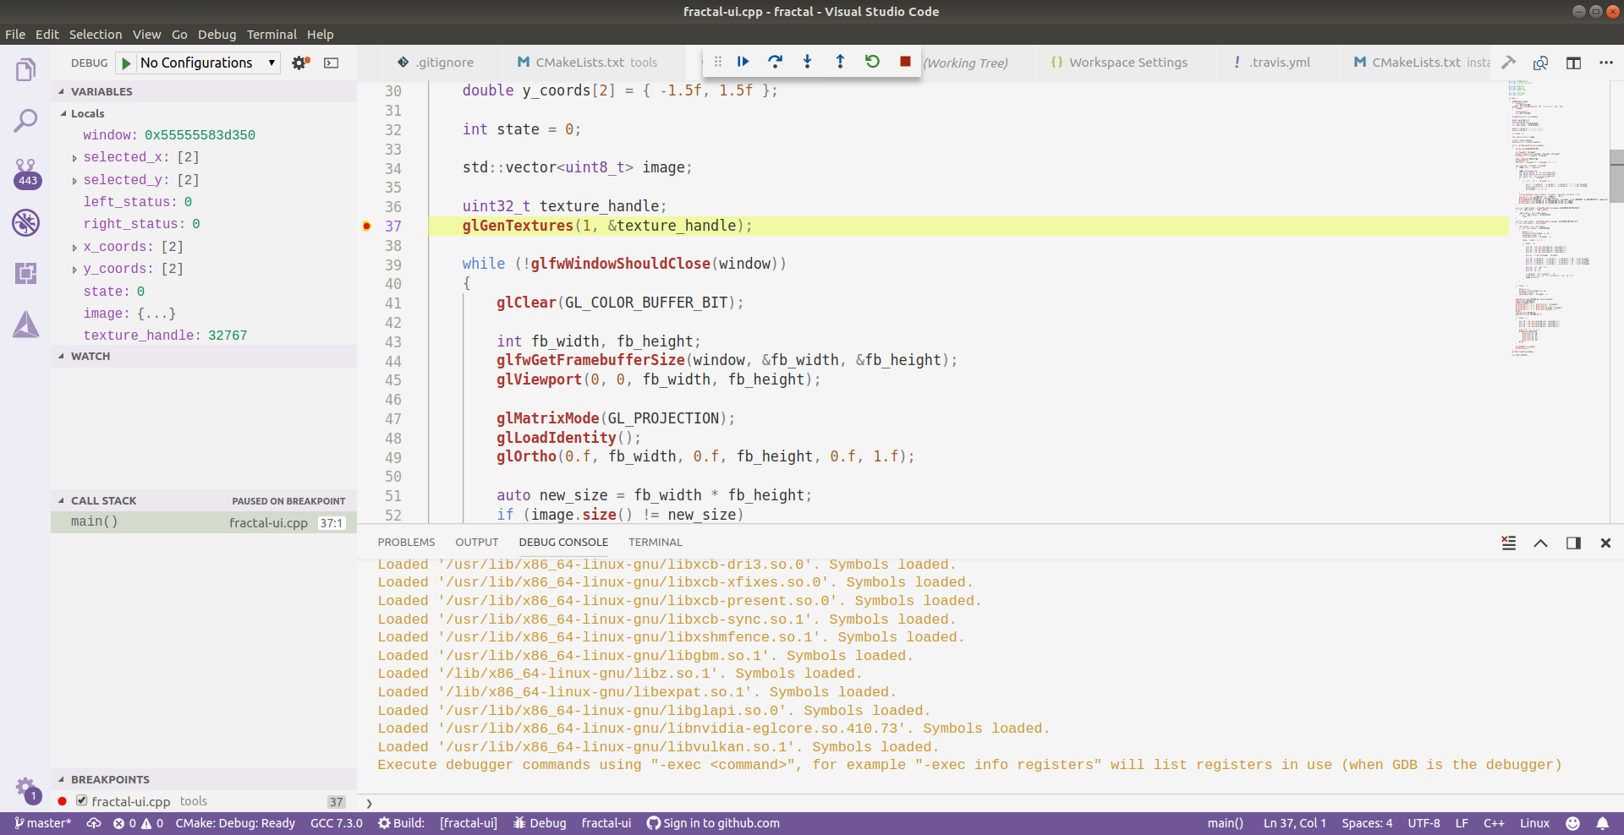
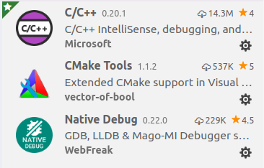
IDE for Cross-Platform Open-Source C++?

Slide 25
Future Topics
Package management with vcpkg and Connan
Integration with Python, .NET, Matlab and Node.js with CMake
Building installers for different platforms
Logging in open-source cross-platform C++
Generating and publishing documentation with Doxygen and GitHub pages
...

